Slide 1


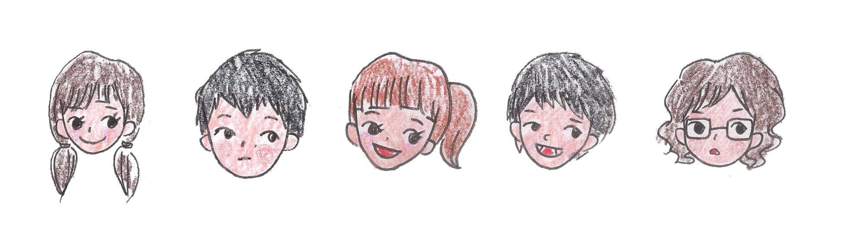
Footprint
By Raonatti
From 5th September to 16th November

Slide 2
c
c
Contents
01 Activities in September
02 Activities in October
03 Activities in November
04 Darshan
05 Program Schedule

Slide 3
1
Bombay YMCA
In September

Slide 4
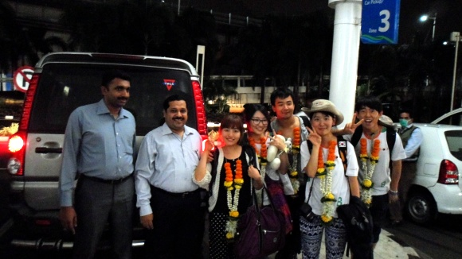
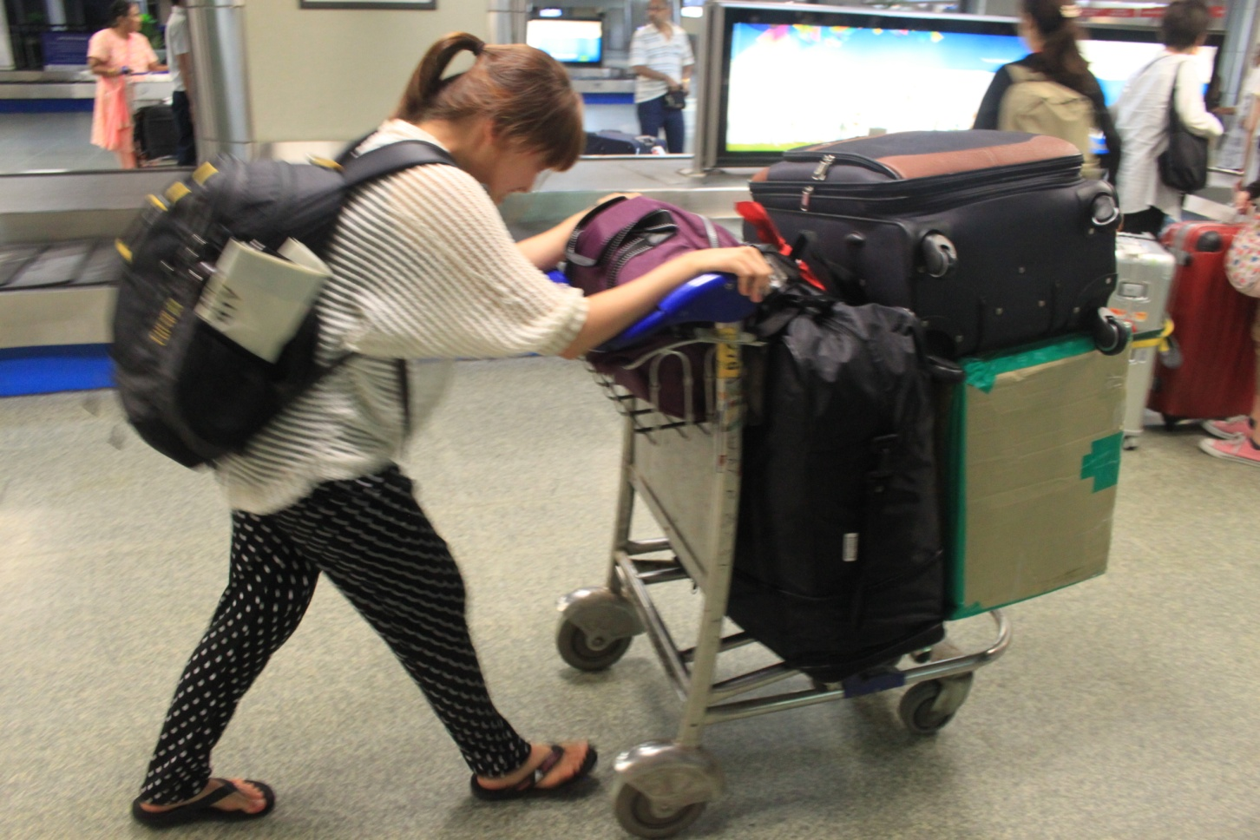


In Sep Bombay YMCA
01 Visit Bombay
YMCA
02 Improvement of
Environment in Balwadi
03 Hindi Class
04 Night Study
Center

Slide 5
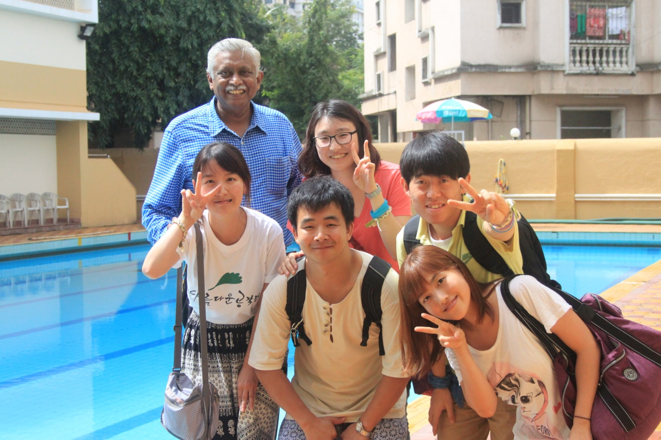
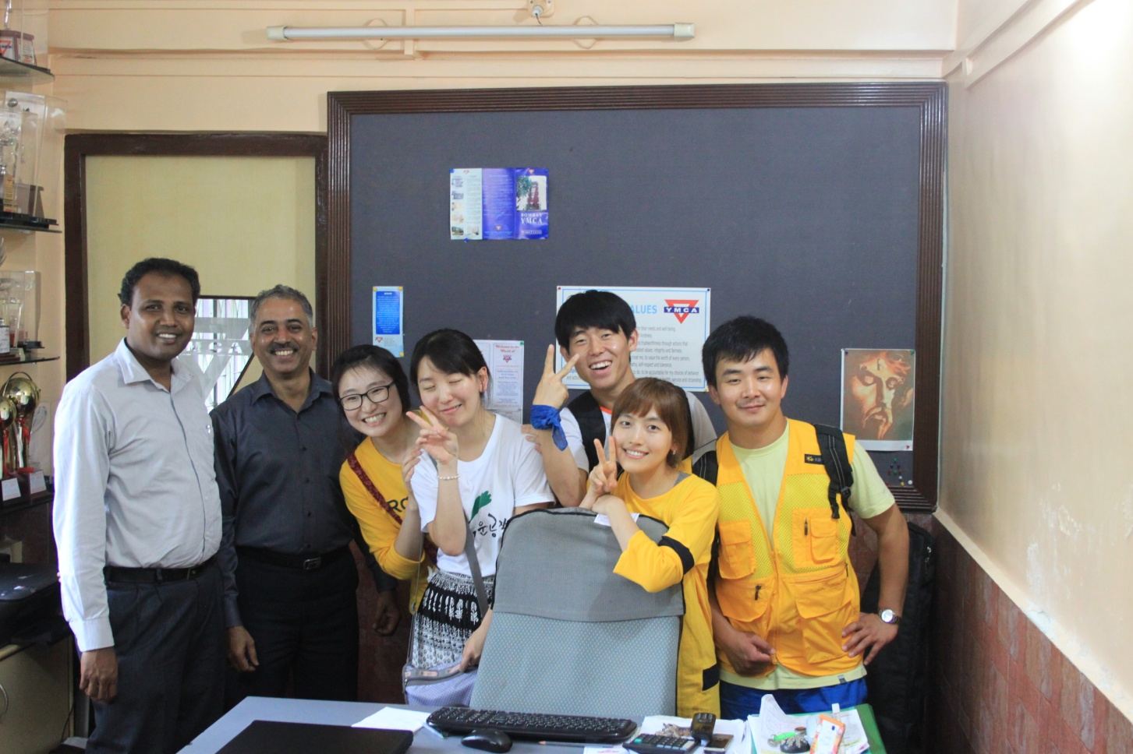
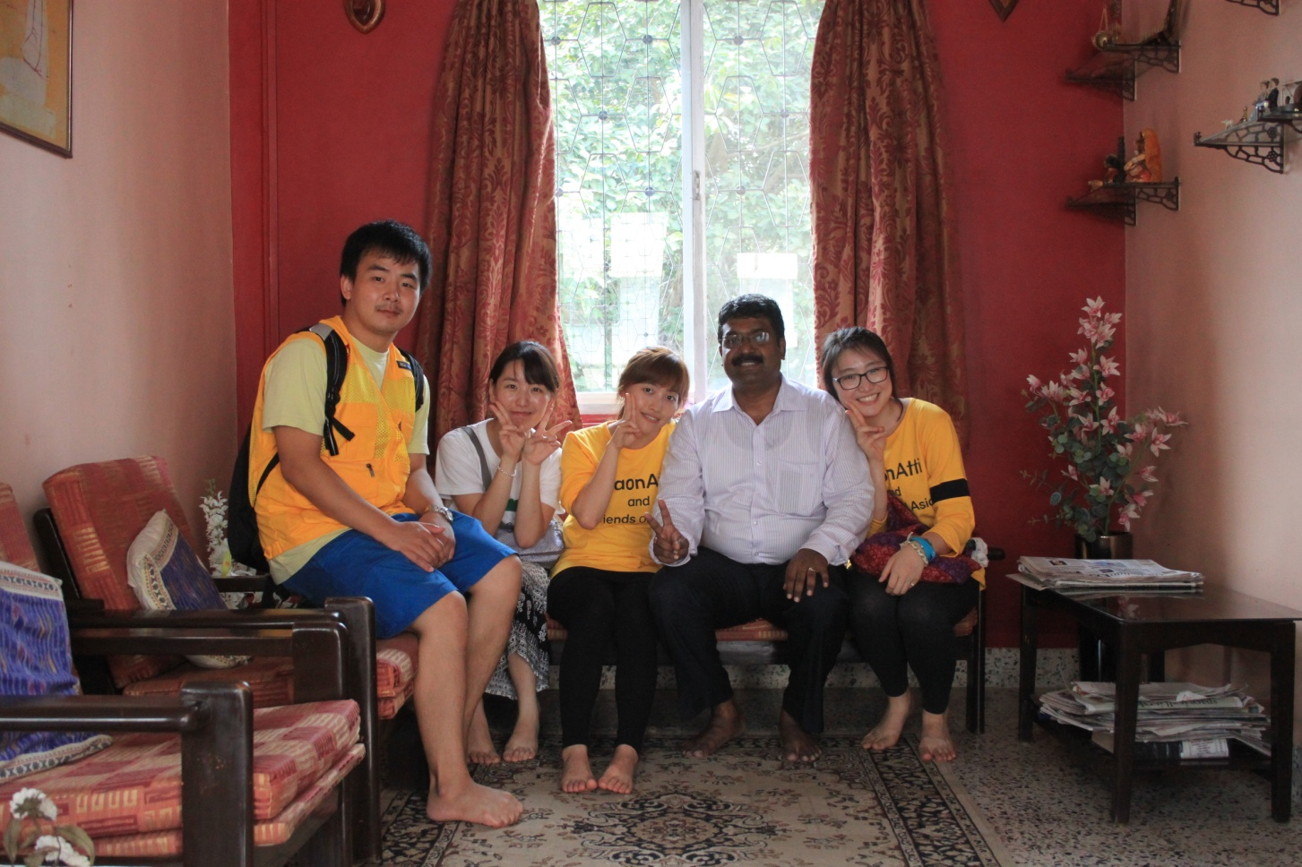
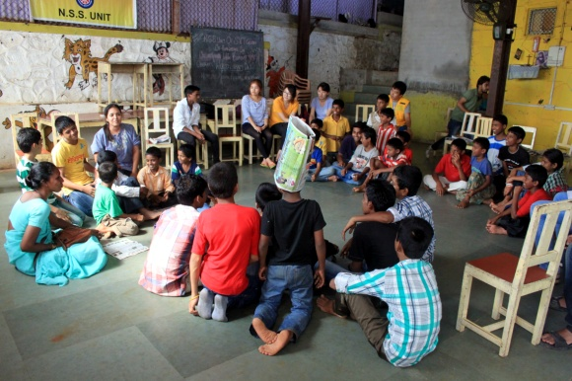
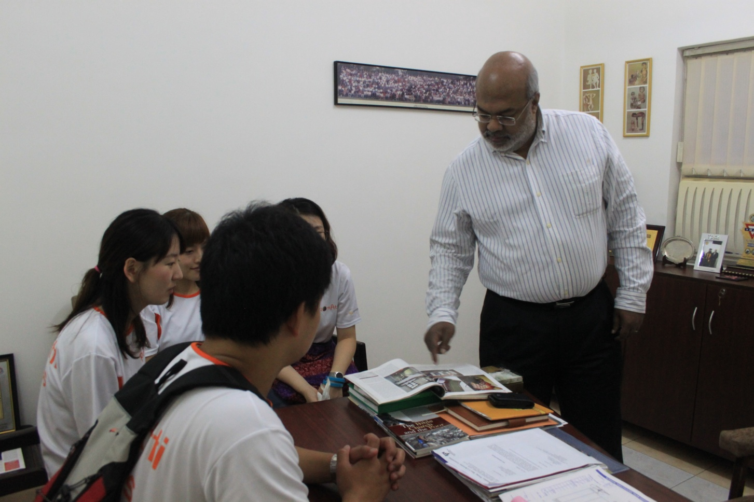
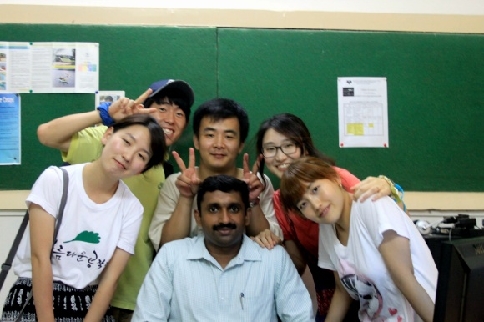
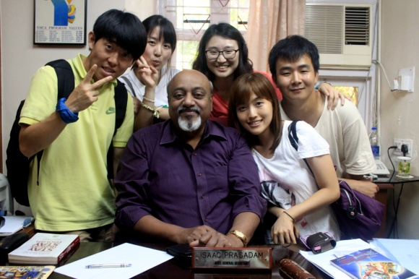
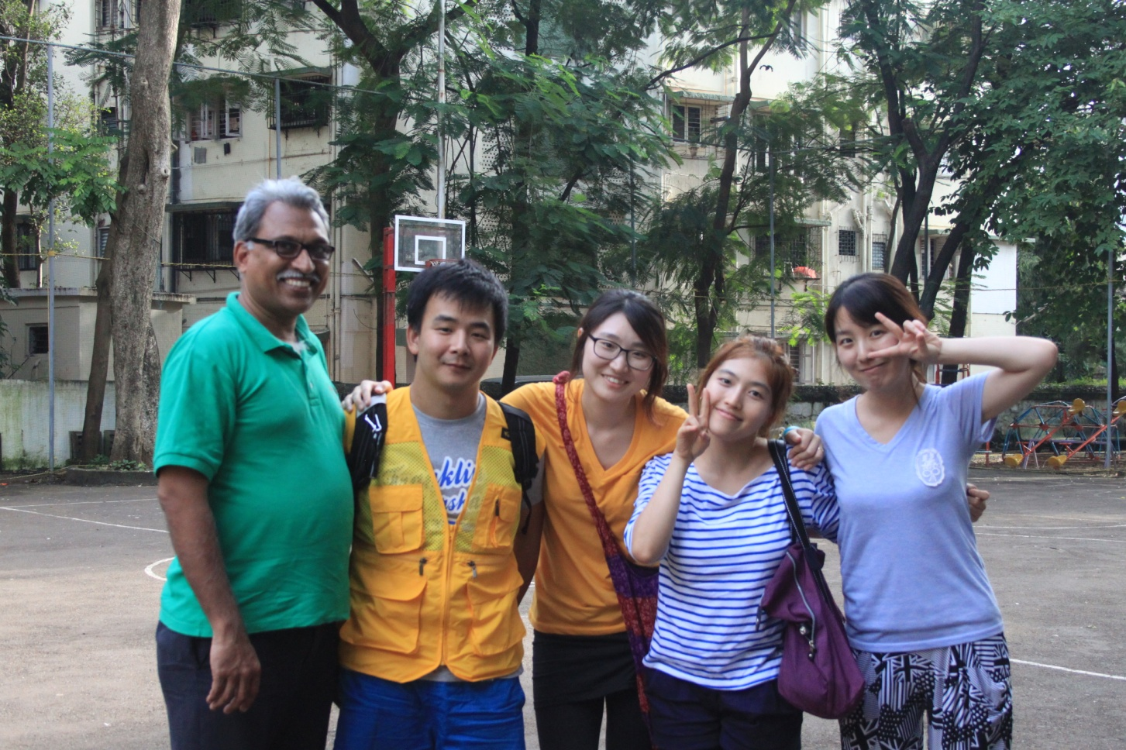


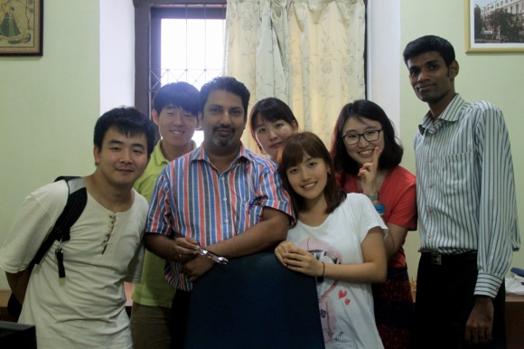


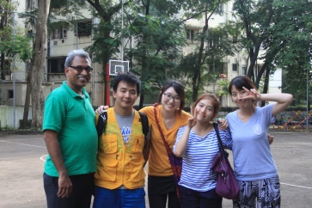
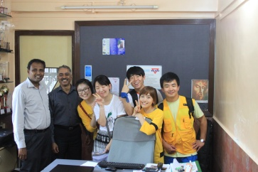



In Sep Bombay YMCA
01 Visit Bombay
YMCA
02 Improvement of
Environment in Balwadi
03 Hindi Class
04 Night Study
Center
BOMBAY YMCA welcomed us with warm-hearted

Slide 6
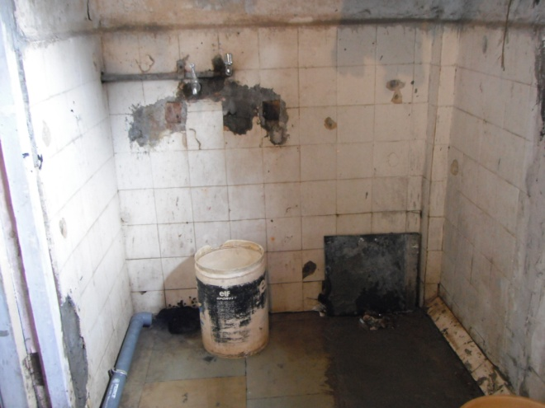
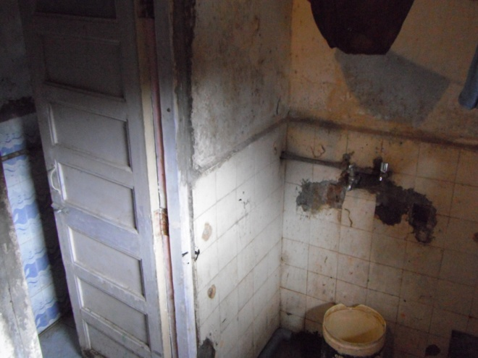
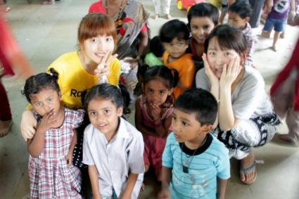
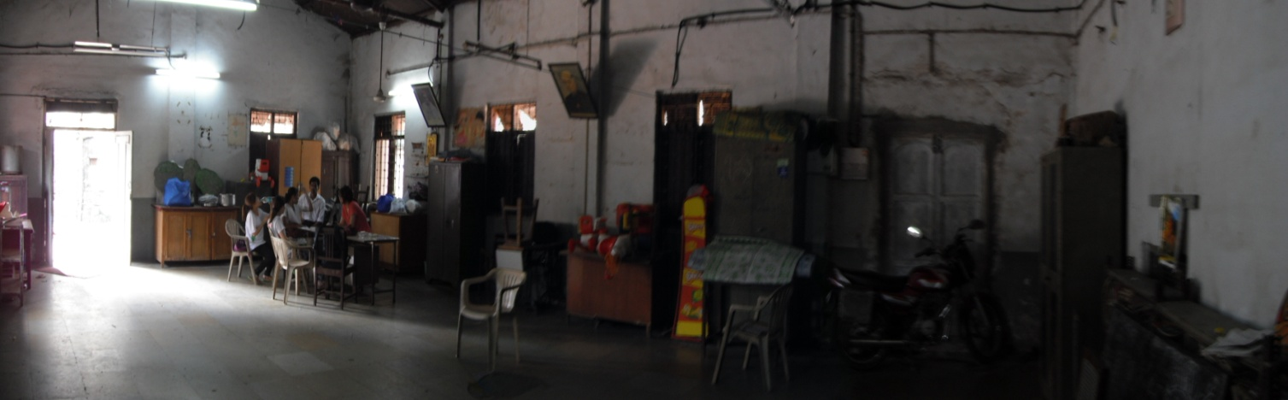
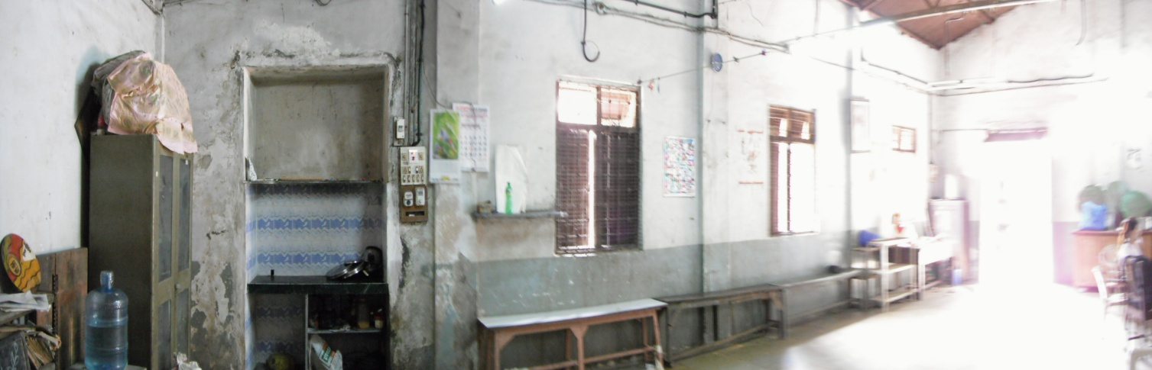
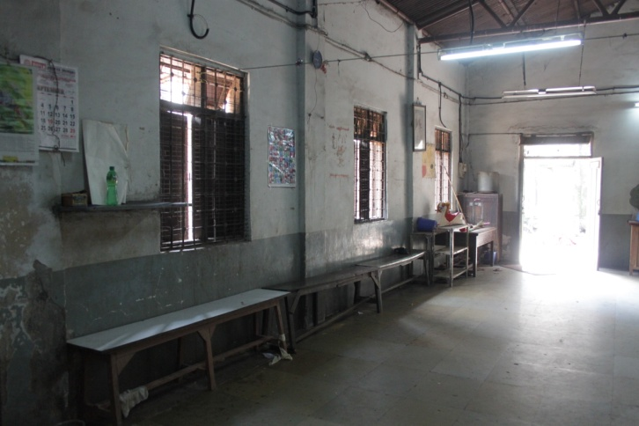
In Sep Bombay YMCA
01 Visit Bombay
YMCA
02 Improvement of
Environment in Balwadi
03 Hindi Class
04 Night Study
Center
Before being CHANGED!!!

Slide 7
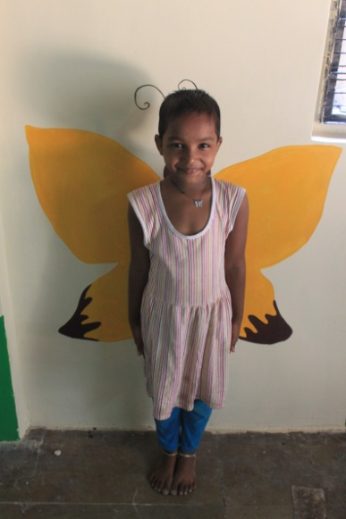
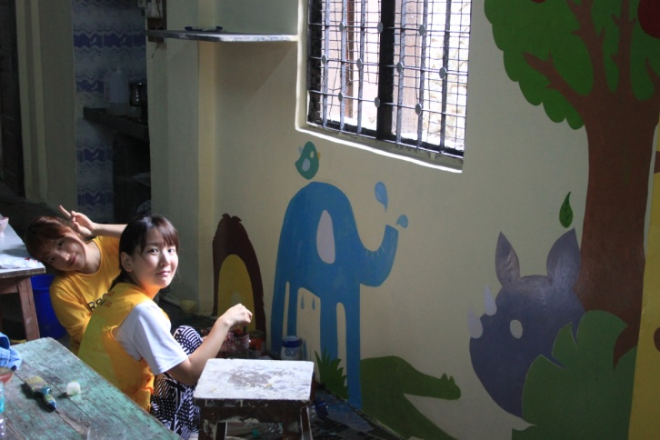
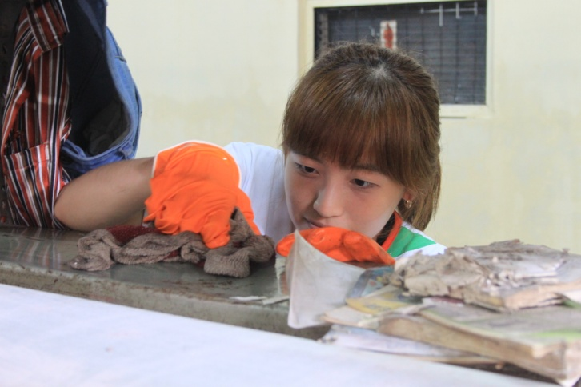
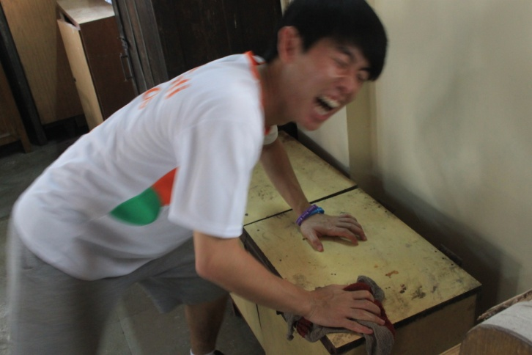
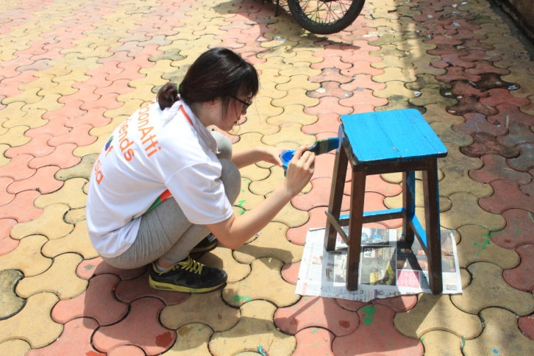
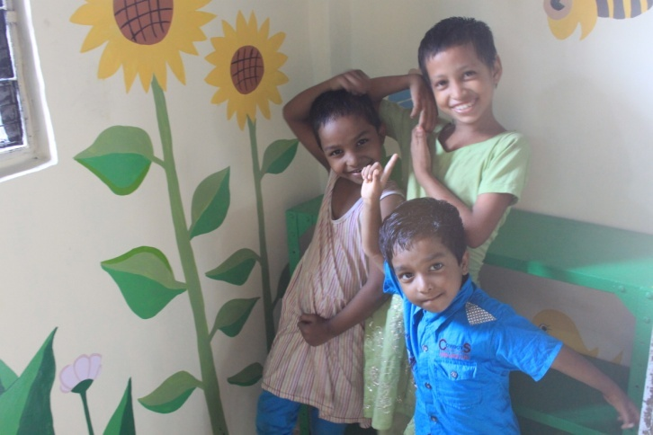
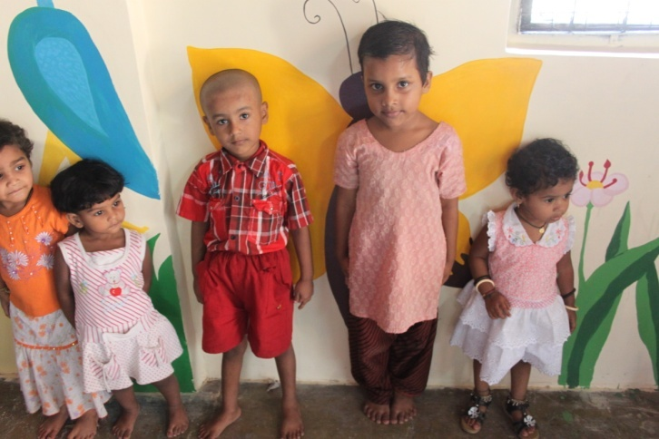
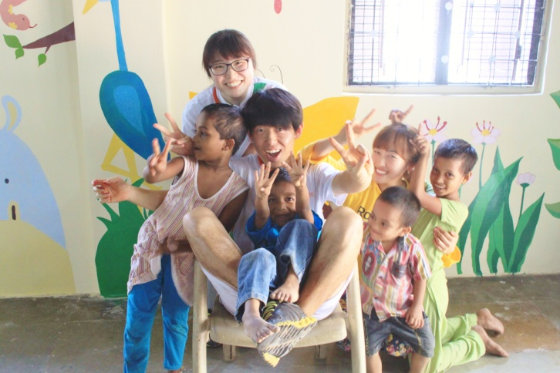
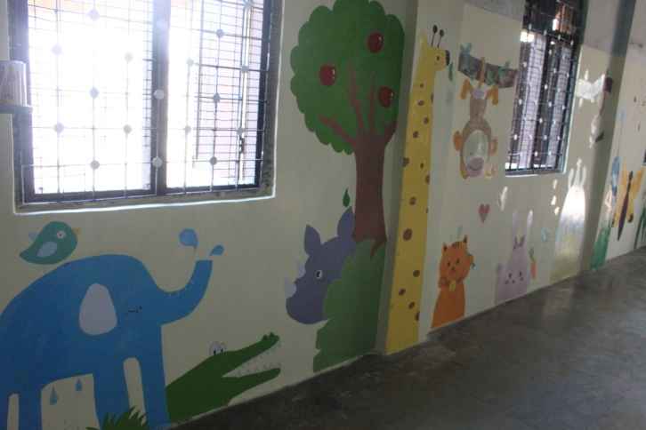
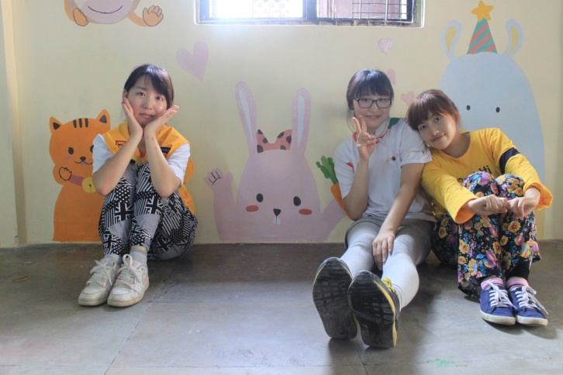
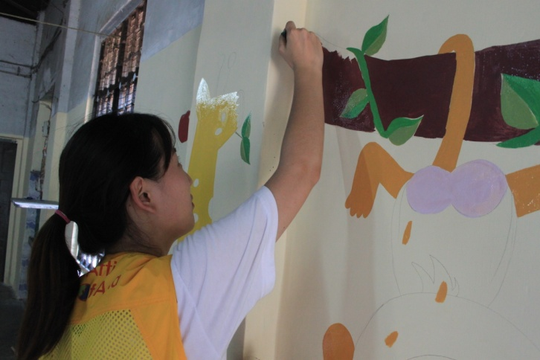
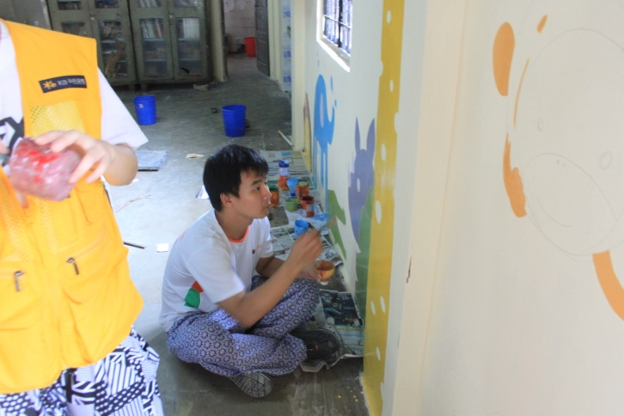
In Sep Bombay YMCA
01 Visit Bombay
YMCA
02 Improvement of
Environment in Balwadi
03 Hindi Class
04 Night Study
Center
CHANGE is going on…

Slide 8

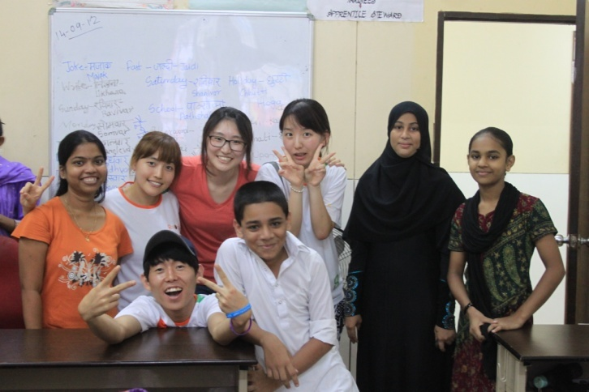

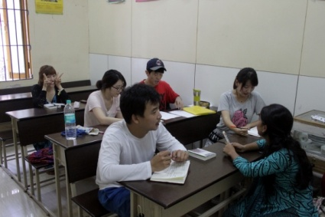

In Sep Bombay YMCA
We took Hindi Class
from 10th to 31th
in September
with Ms. Swapnali
01 Visit Bombay
YMCA
02 Improvement of
Environment in Balwadi
03 Hindi Class
04 Night Study
Center

Slide 9
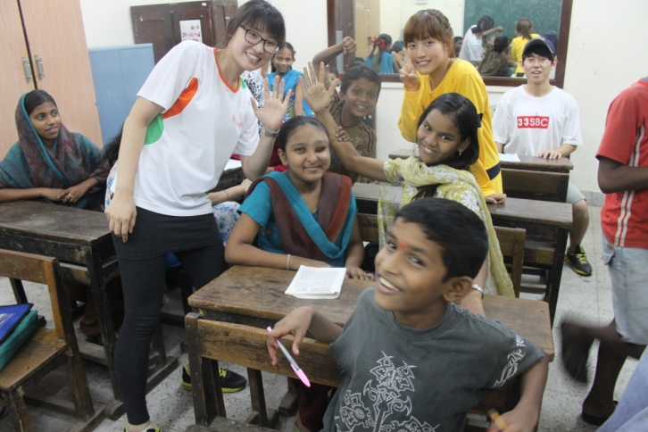
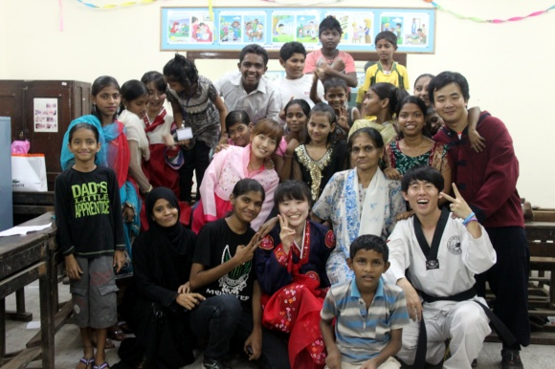
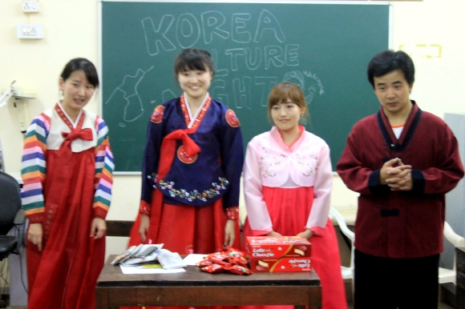
In Sep Bombay YMCA
01 Visit Bombay
YMCA
02 Improvement of
Environment in Balwadi
03 Hindi Class
04 Night Study
Center
Let’s enjoy Korean Culture night with Night study center students

Slide 10
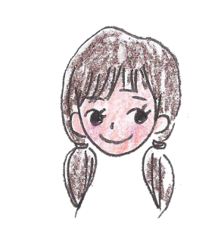

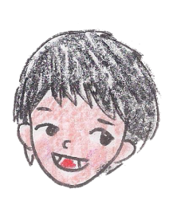

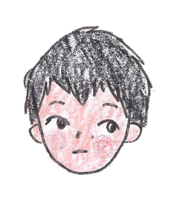
Bombay YMCA In Sep
Thanks to thoughtful consideration of Bombay Y, we adapted to a new environment.
Evaluation
for Activities
It was very great to meet many new people working in Bombay YMCA. Through activity in Balwadi, I realized the importance of education for kids.
Getting familiar with Balwadi children, Bombay Y people, Indian Friends, I could be more energetic.
I learned a lot about Bombay Y and Indian cultures. And I was very happy because we found something we could do for the kids in Balwadi and Night Study Center..
It was really good time to think about the education in India by being together with the kids.

Slide 11
2
Boys Home
In October

Slide 12
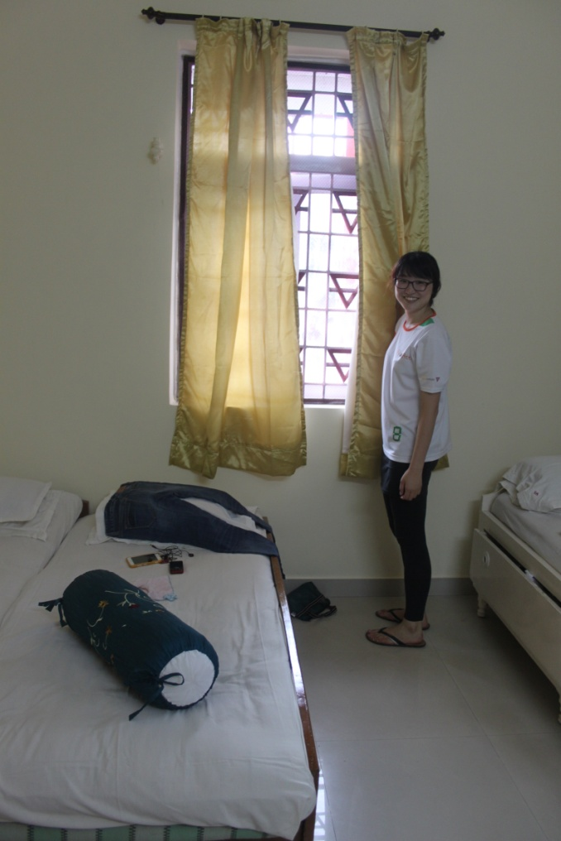
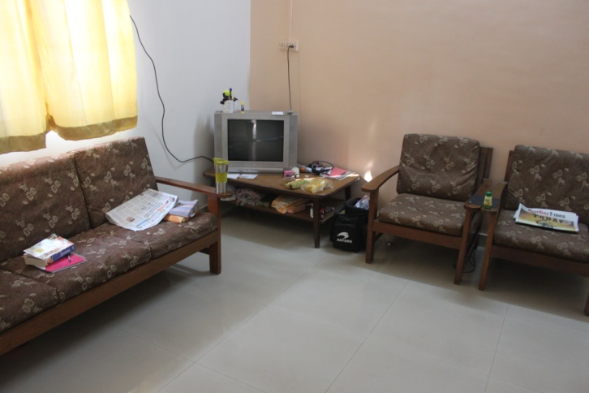
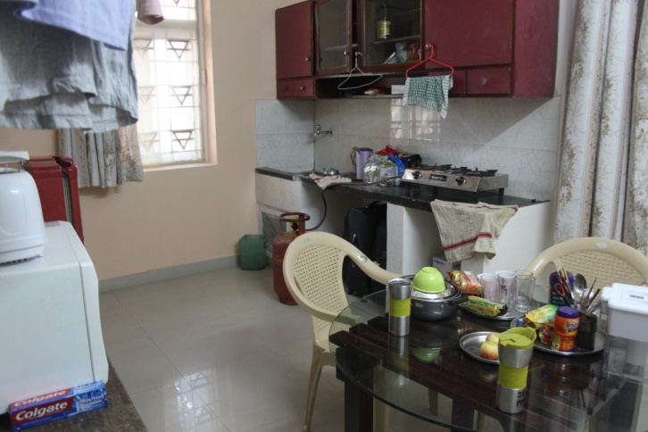
In Oct Boys Home
01 Move to
Boys Home
02 World challenge
03 Tuition for
special children
04 P/G Coaching
(Judo, Soccer)
05 End Poverty
Campaign
Our New home!!!

Slide 13
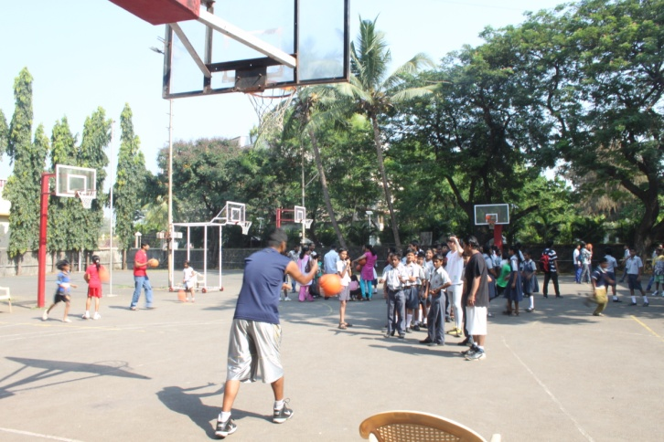
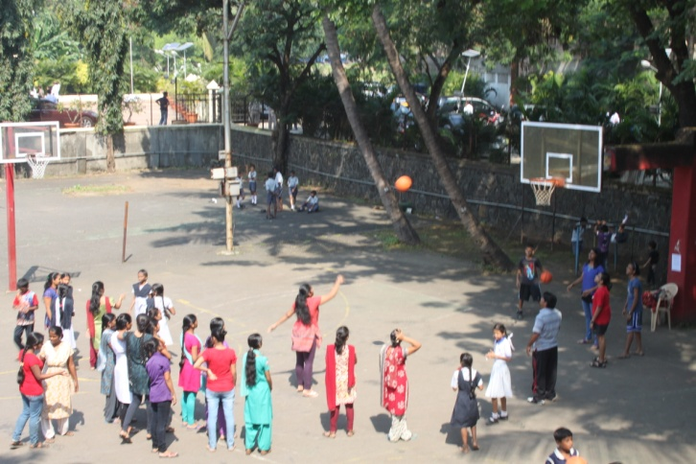
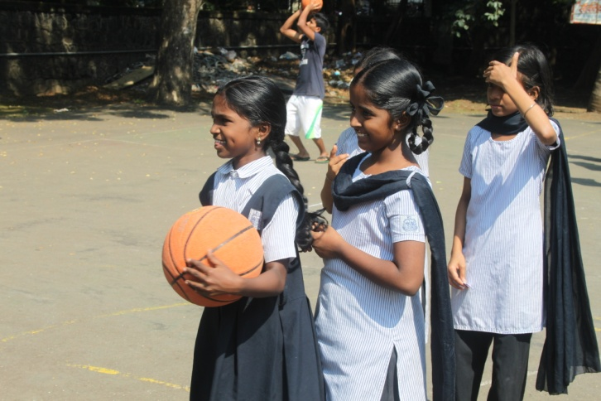
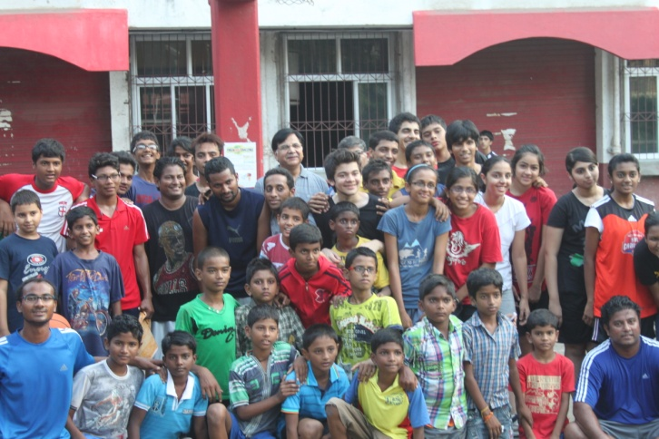
In Oct Boys Home
01 Move to
Boys Home
02 World challenge
03 Tuition for
special children
04 P/G Coaching
(Judo, Soccer)
05 End Poverty
Campaign

Slide 14
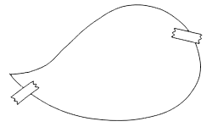
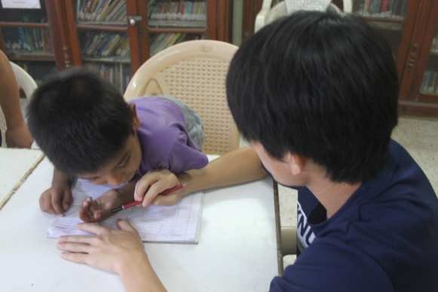

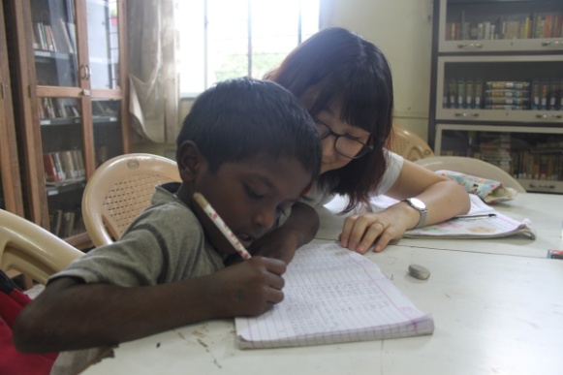

In Oct Boys Home
Rahul: 5+7=?
Adi: …….
01 Move to
Boys Home
02 World challenge
Naina: good job!
Bala: kkk
03 Tuition for
special children
04 P/G Coaching
(Judo, Soccer)
05 End Poverty
Campaign
In every morning from 8:00~9:30 AM

Slide 15







In Oct Boys Home
Didi! Catch me!!
01 Move to
Boys Home
02 World challenge
Follow me, Adi, Arun Bro!!
03 Tuition for
special children
04 P/G Coaching
(Judo, Soccer)
Do not use your hands!
05 End Poverty
Campaign

Slide 16






In Oct Boys Home
From 15th to 18th, we had educated about ‘Poverty’ all around the world in Asha kiran, Sawasrati school, YWCA and Boys home.
01 Move to
Boys Home
02 World challenge
03 Tuition for
special children
We accomplished our ‘End poverty campaign’ successfully.
04 P/G Coaching
(Judo, Soccer)
05 End Poverty
Campaign
Notes:
From 15th to 18th, we had educated about ‘Poverty’ all around the world in Asha kiran, Sawasrati school, YWCA and Boys home.
We accomplished our ‘End poverty campaign’ successfully.

Slide 17
In Oct Boys Home
I was so happy as much as I could feel. We spent enjoyable time in Boys’ home
Evaluation
for Activities
I have enjoyed getting familiar with children and understanding their lives in Boys home. It was so nice that Allen sir and Raphael take care of us very well.
For this month, I considered about what I could do here for the children. And End Poverty Campaign was good time for thinking about poverty not only in India, but also in Korea.
I was touched by warm-hearted welcome by Boys’ Home children. During the End Poverty Campaign week, I could have the time to think about types of poverty in Korea as well as in India.
In October, I was totally fascinated by Boys’ Home children.

Slide 18
3
Boys Home
In November

Slide 19



In Nov Boys Home
Too much work-loaded……..
01 Library Work
02 Attending
School with Children
0
Even in Diwali!!!

Slide 20




In Nov Boys Home
01 Library Work
02 Attending
School with Children
Didi, are you going to go to school with us today?
0

Slide 21
In Nov Boys Home
c
We were busy with the library work. I hope it can be helpful to Boys’ home children.
Evaluation
for Activities
It was a pity that it could not be moved to ground floor for library. I think that It needs more space for children to study. Happy to see children enjoying their going to school with us.
Regarding the library project, it was very hard time for me because I prefer more active and energetic activities. However, I feel satisfied with the improvement of the library.
I become familiar with Boys’ Home children. Hope to have a good time with them and make attractive library for them.
I am making effort to find something I can do for Boys’ Home and VTC by understanding them.

Slide 22
4
Darshan

Slide 23



Darshan
01 Ganesh Festival
02 Bandra Fair
03 Chris’ Wedding
Anniversary

Slide 24




Darshan
01 Ganesh Festival
02 Bandra Fair
03 Chris’ Wedding
Anniversary
Going out with Carlos’ Club

Slide 25




Darshan
01 Ganesh Festival
02 Bandra Fair
03 Chris’ Wedding
Anniversary
Chris’ happiness is over……(kkk kidding)
Congratulation!

Slide 26
Darshan
Indian culture is so amazing. It is always delightful for me to be invited to Indians’ house. I hope to learn more about Indian culture
Evaluation
for Activities
I love Indian culture, especially bollywood dance! Every Indians welcomed us.
I experienced diverse Indian festivals. Even if they were based on different religions from mine, Christian, I would not forget the extremely happy moments.
I could find the similarities and differences between Indian and Korean cultures. Everyone in the world wants to enjoy happy moments in different ways!
I felt Indian cultures were so attractive and I learned how to enjoy them.

Slide 27
5
Program
Schedule

Slide 28
Program Schedule
● P/G Coaching Plan
- Enhancement the quality of Judo and Soccer class
- Participate in Basketball coaching
● Tuition for special children
● Holiday: Goa beach in December
● Conduct the library project
Working with library D/B
Install ‘search bar’
Improvement program for library activation
● Project on Toy Library
●Activity in Juhu Beach (undecided)
01 Activity Plan

Slide 29

Thank you

