Slide 1
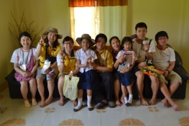
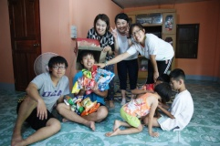
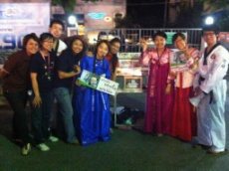
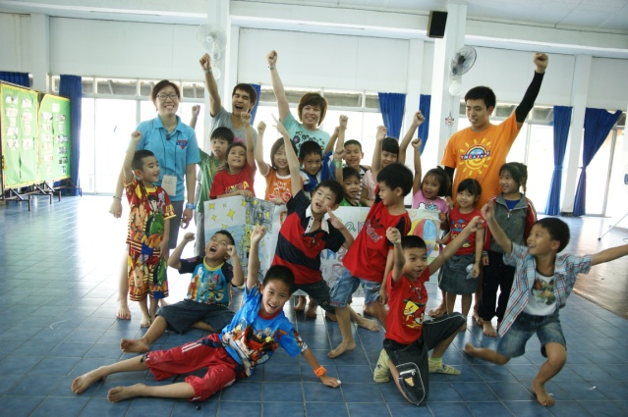
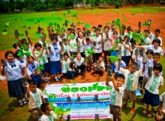
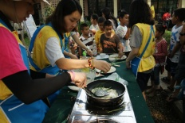
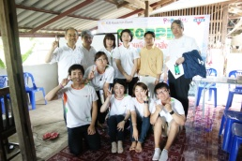
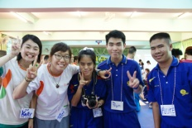
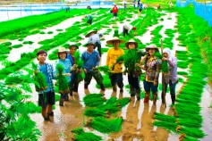
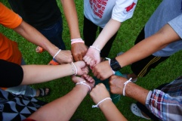
ยินดีต้อนรับ
hello
สวัสดีครับ
Welcome to our party

Slide 2
Raonatti 7th Thai team

Slide 3
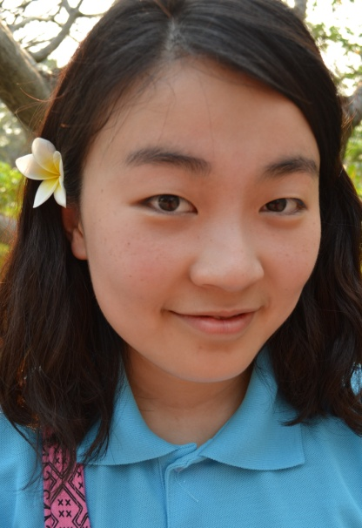
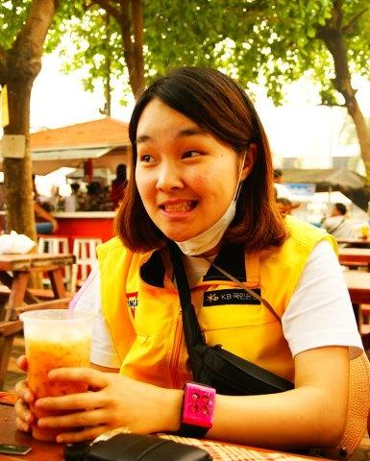
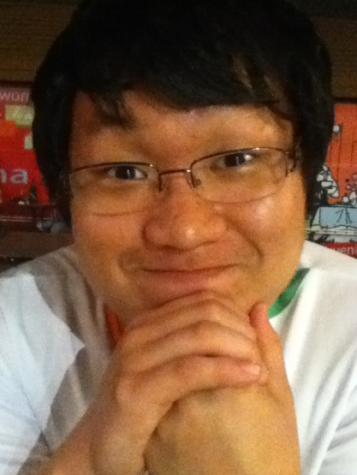
Raonatti 7 !!! Who are you guys?
Kim Sun Yang
(ตนตาล)
Kim So Hyun
(กะทิ)
Yang Seung Hui
(น้ำผึ้ง)
Kim In Young
(ใบเตย)
Park Kyu Hwan
(ขนุน)

Slide 4
Our family
P’Di
P’Pare
P’Yo
P’Mom
P’Nang
P’Sing
P’Piyak
P’Ton

Slide 5
Schedule Table

Slide 6
March
ChiangMai
ChiangRai
Sun | Mon | Tue | Wed | Thu | Fri | Sat
4 | 5 | 6 | 7 Arrived Chiang Mai | 8 Thai class Orientation Welcome party | 9 Thai class | 10 Join the YMCA activity at SKP YMCA
11 Activity with The YMCA (activity with Street Children) | 12 ~ 14 Environmental with YMCA network (local wisdom homestay in wiang papao) |  |  | 15 Presentation CLP | 16 Prepare Activities and Materials for Korean Language | 17 Activities at Town Center : Korean Language
18 Day off | 19 Day Camp Make picture dictionary | 20 Day Camp Make picture dictionary | 21 Go to Maesai District Community study | 22 Study Tour with Day Camp Make picture dictionary | 23 Day Camp Make picture dictionary | 24 Activities at Town Center : Korean Food
25 Day off | 26 Day Camp Organic Vegetable | 27 Day Camp Organic Vegetable | 28 Day Camp Organic Vegetable | 29 Day Camp Organic Vegetable | 30 Visit/Follow up CLP Cases in Mea Chan District | 31 Activities at Town Center : Get to know about Korea

Slide 7
April
ChiangMai
ChiangRai
Sun | Mon | Tue | Wed | Thu | Fri | Sat
1 Day off | 2 Day Camp | 3 Day Camp | 4 Visit/Follow up CLP Cases in Phan District | 5 Day Camp | 6 Day Camp | 7 Activities at Town Center : Korean song CLP Fundraising at Walking street
8 Day off | 9 Visit/Follow up CLP Fha Luang District Stay over night | 10 Go to ChiangMai | 11 ~ 16 Activities in ChiangMai (Songkran fest)
 |  | 17 Preparing to stay in the village | 18 ~ 21 Visit organic village (Tamdokkham)
22 Day off | 23 Go to ChiangRai Day Camp | 24 Day Camp | 25 Day Camp | 26 Day Camp | 27 Day Camp | 28 Presentation to show your work in ChiangRai Afternoon CLP Fundraising in Maesai at Walking street
29 CLP family camp | 30 CLP family camp Go to ChiangMai

Slide 8
May
ChiangMai
Tamdokkham
Sun | Mon | Tue | Wed | Thu | Fri | Sat
 |  | 1 Preparing to welcome the coordinator team | 2 Preparing to welcome the coordinator team | 3 Welcome coordinator team | 4 Preparing to welcome the coordinator team | 5 Our activities presentation
6 Day off | 7 Day off | 8 SKP YMCA Thai class | 9 SKP YMCA Thai class | 10 Visa trip | 11 SKP YMCA Thai class | 12 SKP YMCA Thai class
13 Day off | 14 SKP YMCA Thai class | 15 SKP YMCA Thai class | 16 SKP YMCA Thai class | 17 SKP YMCA Thai class | 18 SKP YMCA Thai class | 19 Activity in SKP YMCA
20 Day off | 21 Preparing for volunteering program in the school | 22 volunteering program in the school | 23 volunteering program in the school | 24 volunteering program in the school | 25 volunteering program in the school | 26 Village activity
27 Village activity | 28 volunteering program in the school | 29 volunteering program in the school | 30 volunteering program in the school | 31 volunteering program in the school

Slide 9
June
ChiangMai
Tamdokkham
Sun | Mon | Tue | Wed | Thu | Fri | Sat
 |  |  |  |  | 1 Voulnteering program in the school | 2 Helping house work & farming
3 Helping house work & farming | 4 Voulnteering program in the school | 5 350ppm campaign | 6 Voulnteering program in the school | 7 Voulnteering program in the school | 8 Planting tree in school | 9 Helping to sell products in market & back to SKP YMCA
10 Day off | 11 Voulnteering program in the school | 12 Voulnteering program in the school | 13 Voulnteering program in the school | 14 Voulnteering program in the school | 15 Voulnteering program in the school | 16 Helping house work & farming
17 Helping house work & farming | 18 Voulnteering program in the school | 19 Voulnteering program in the school | 20 Voulnteering program in the school | 21 Voulnteering program in the school | 22 Voulnteering program in the school | 23 Helping house work & farming
24 Helping house work & farming | 25 Voulnteering program in the school | 26 Voulnteering program in the school | 27 Voulnteering program in the school | 28 Voulnteering program in the school | 29 Voulnteering program in the school | 30 Helping to sell products in market & Village middle report

Slide 10
July
ChiangMai
Tamdokkham
Sun | Mon | Tue | Wed | Thu | Fri | Sat
1 Helping house work & farming | 2 Voulnteering program in the school | 3 Voulnteering program in the school | 4 Voulnteering program in the school | 5 Voulnteering program in the school | 6 Voulnteering program in the school | 7 Helping house work & farming
8 Helping house work & farming | 9 Voulnteering program in the school | 10 Voulnteering program in the school | 11 Voulnteering program in the school | 12 Voulnteering program in the school | 13 Voulnteering program in the school | 14 Helping to sell products in market
15 Helping house work & farming | 16 Planting tree in wat tamdokkam & back to SKP YMCA | 17 Preparing Green ambassador camp | 18 Preparing Green ambassador camp | 19 ~ 20 Green ambassador camp |  | 21 ~ 30 Traveling in Thailand
21 ~ 30 Traveling in Thailand
21 ~ 30 Traveling in Thailand |  | 31

Slide 11
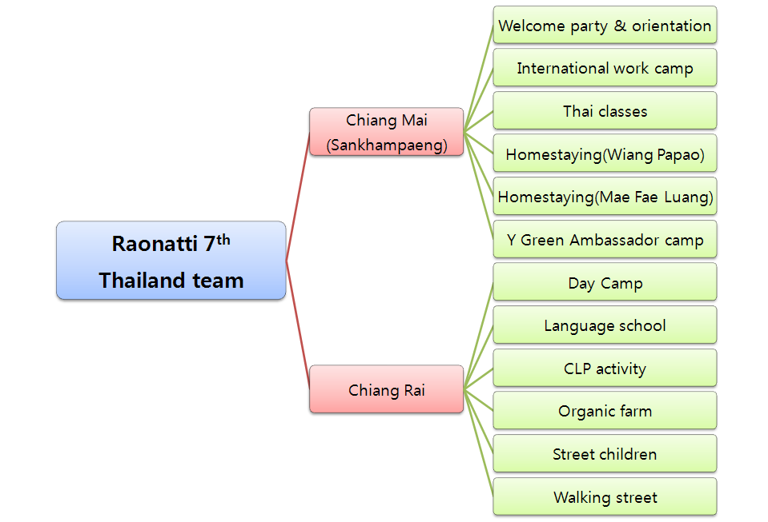
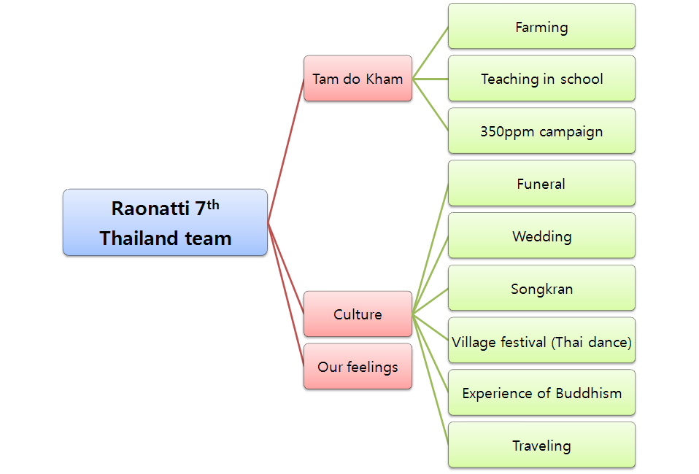
Raonatti 7th
Thailand team
Chiang Mai <Sankhampeang>
Welcome party &
Orientation
International youth work camp
Chiang Rai
YMCA
Thai class
Homestay
(Wiang papao)
NWDF(Northern Women’s Development Foundation)
Day camp
Language school
Organic farm
CLP
Office
Fund-raising
Visiting(hospital, houses)
CLP family camp
Hill-tribe homestay
Street children
Tam dok kham
Teaching in school
350ppm campaign
Home staying & Farming
Thai culture

Slide 12
Contents
Chiang Mai (Sankhampaeng)
- Welcome party
- Orientation of environmental campaign
- Village home-stay (Wiang papao)
- Green Ambassador camp
Chiang Rai
- Day camp & Language school
- CLP(cleft lip/palate)
Tam dok kham village homestay
- Teaching in school (Sahakon Damri)
- 350ppm campaign
- Homestaying life
Thai Culture
Our Feelings

Slide 13
Chiang Mai

Slide 14
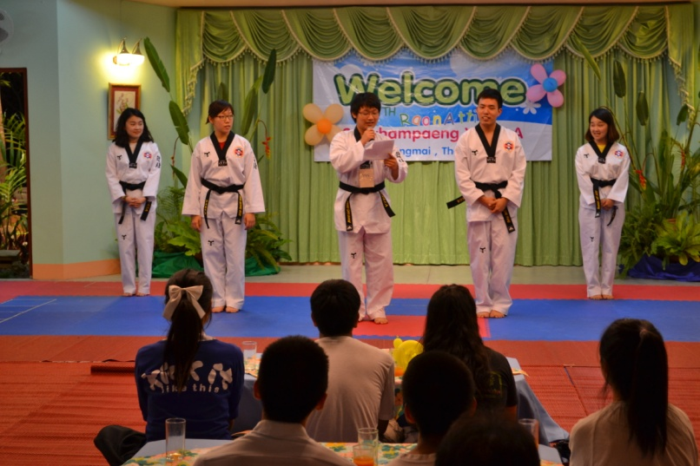
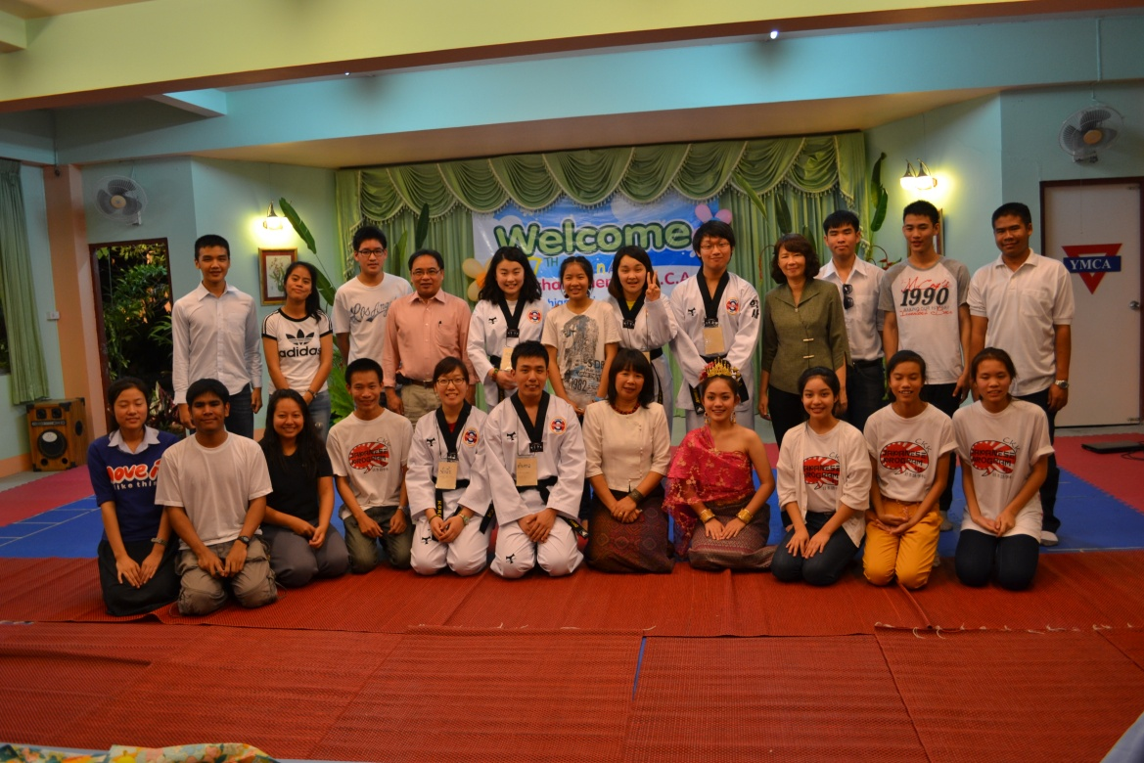
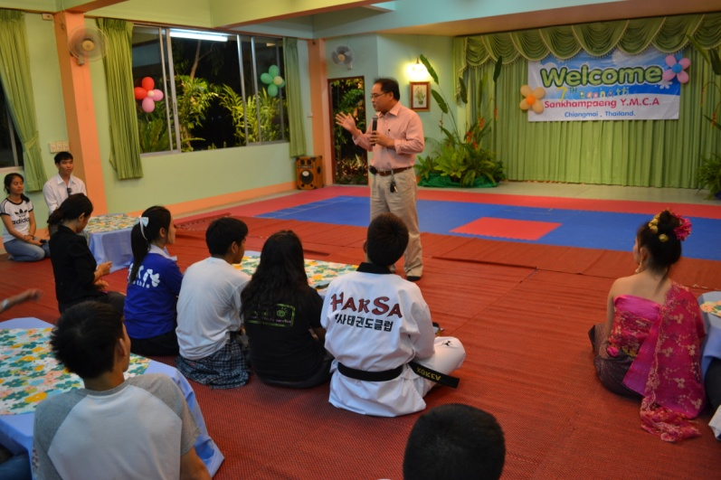
Welcome Party
On the next day we arrived, many YMCA staffs and JKY students celebrated and welcomed us with their pleasure.

Slide 15
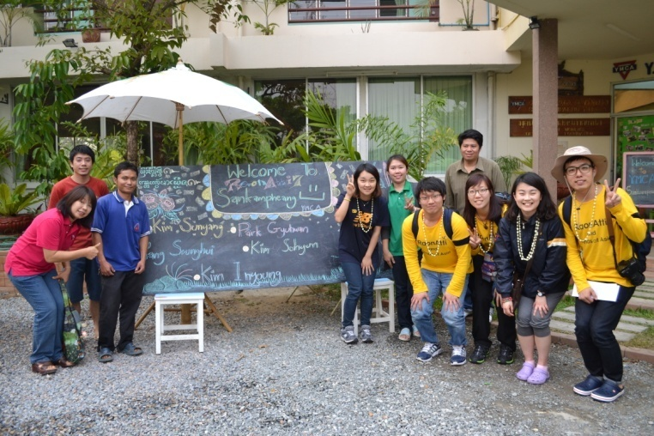
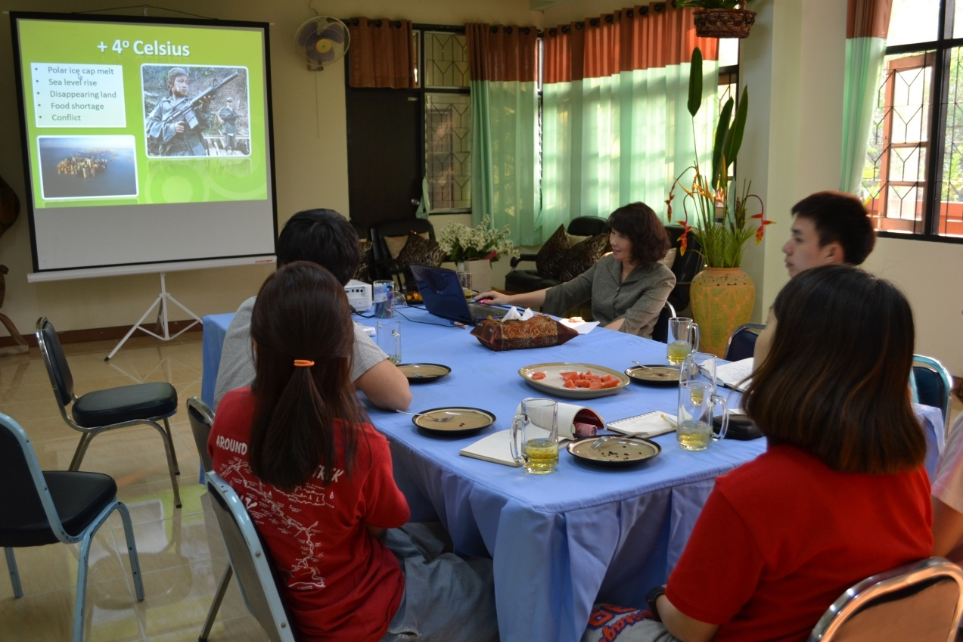
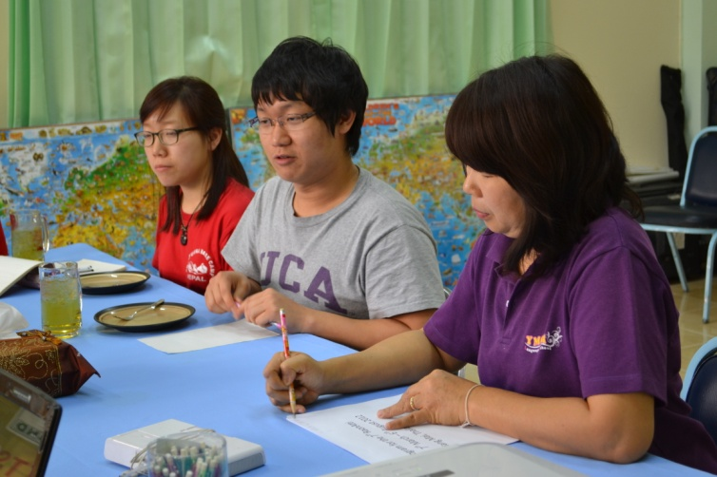
Orientation of environmental campaign
We had a presentation from Patcharin that has message of environmental pollution and global warming.
This orientation helped us a lot to gain a general conception of our practical behaviors toward environment.

Slide 16
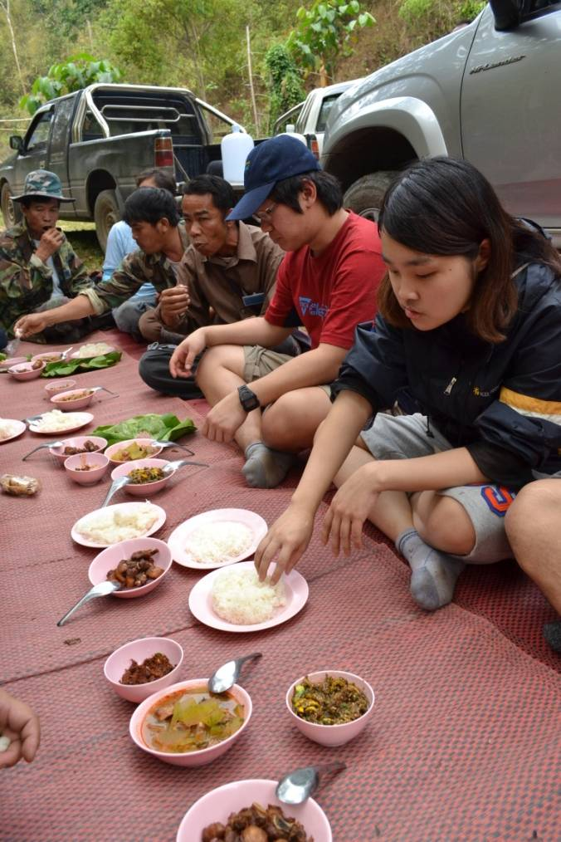
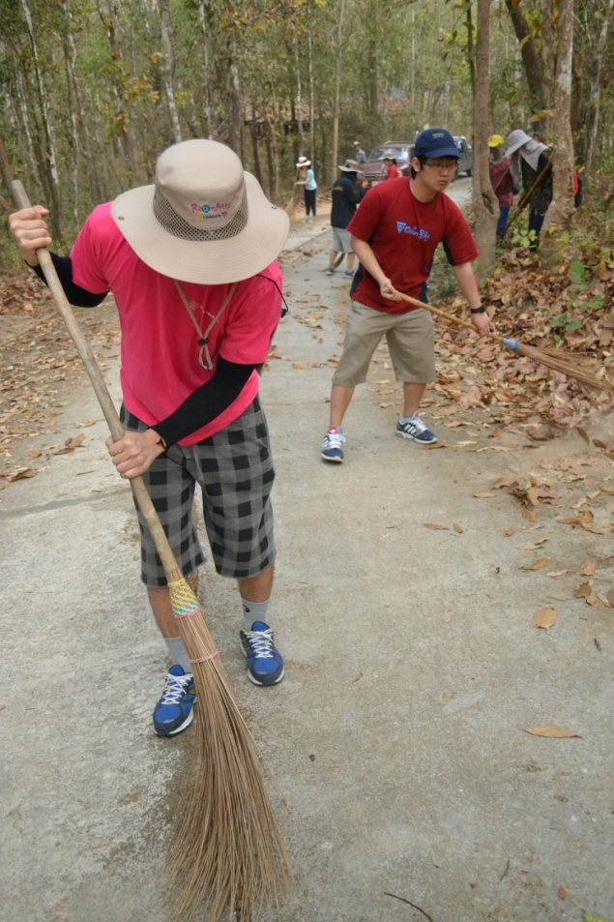
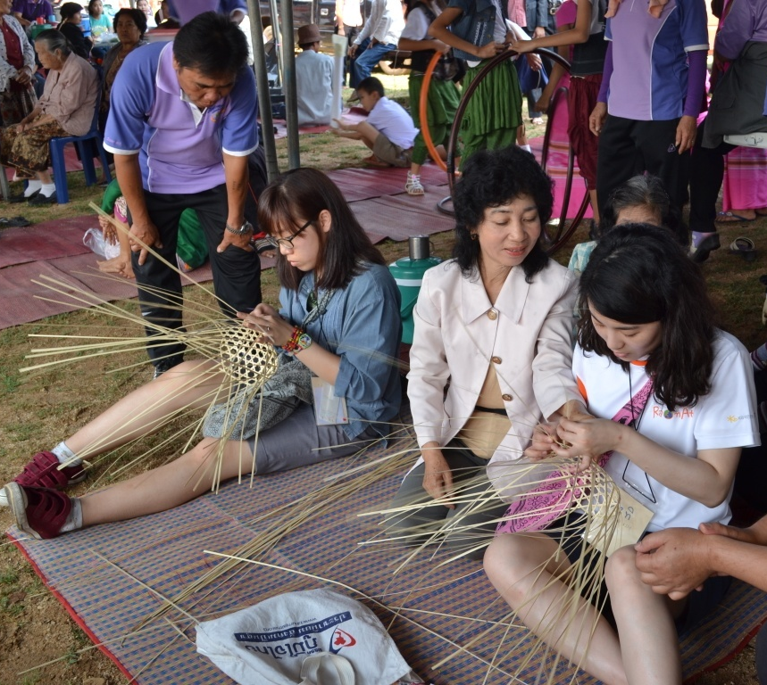
Village home-stay(Wiang Papao)
Over three days, we’ve done so many things such as building fire protection line.
We observed how the function of community works among village people

Slide 17
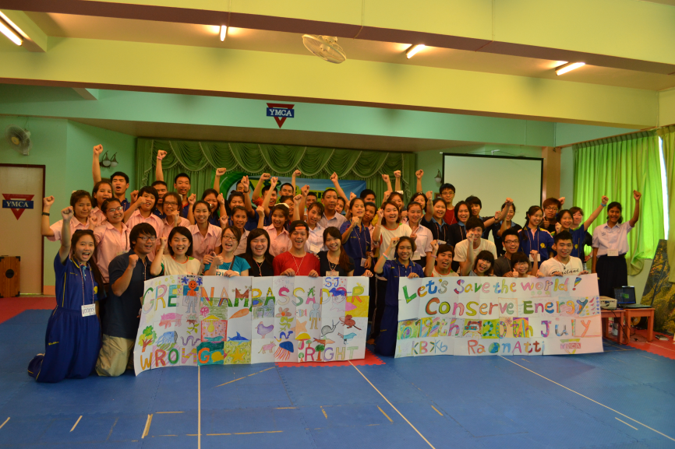
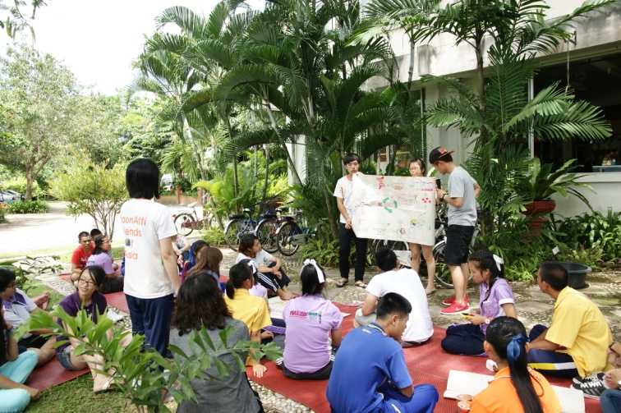
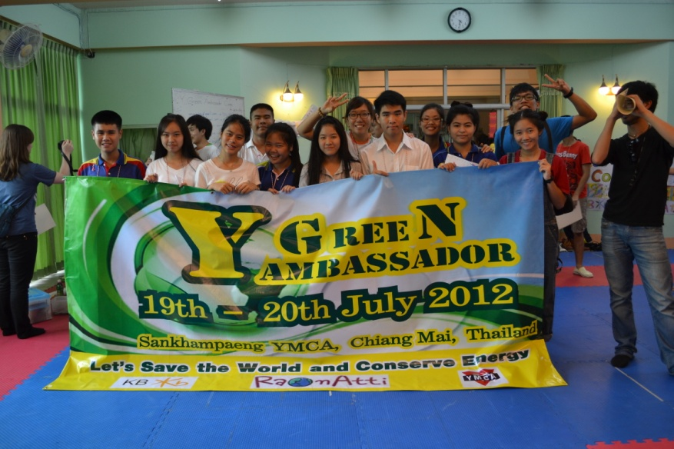
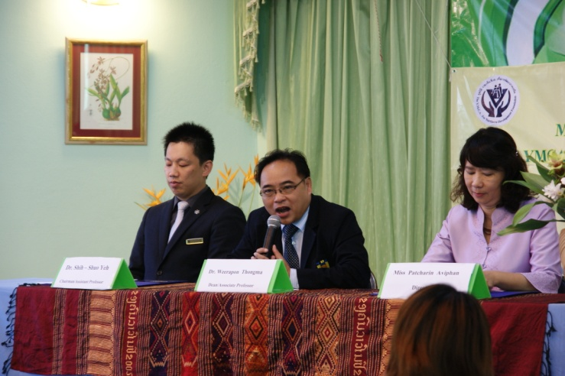
Green Ambassador Camp
During 2 days, we had many students from different places and countries. It was time we could get close both with teammates and environment.
Despite of our pressure to run programs by ourselves, we are very satisfied that we got to finish the camp successfully .

Slide 18
Chiang Rai Day camp & Language school

Slide 19
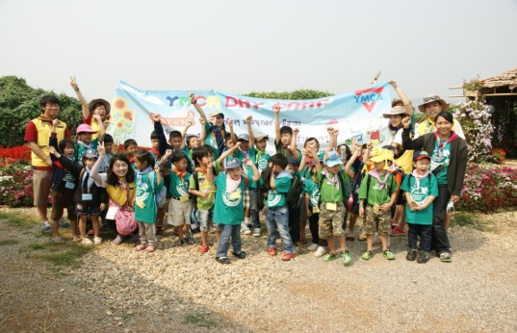
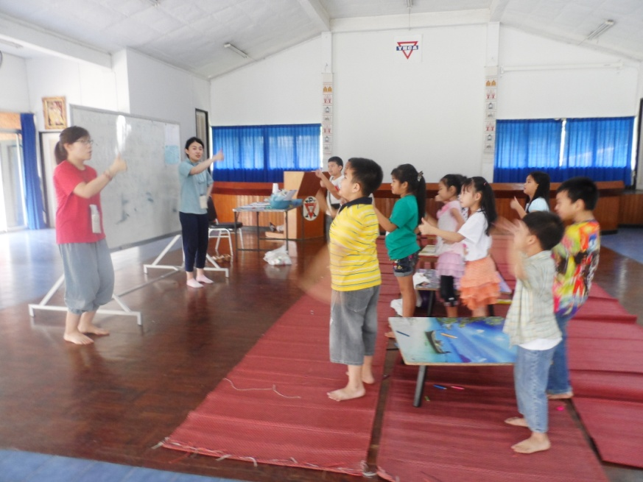
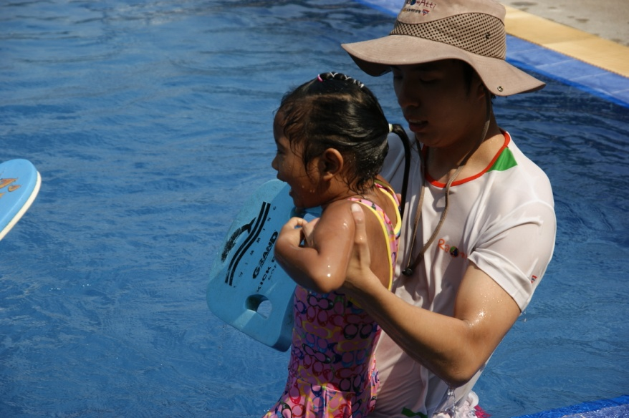
Day camp
- Day camp was practice to get familiar with children.

Slide 20
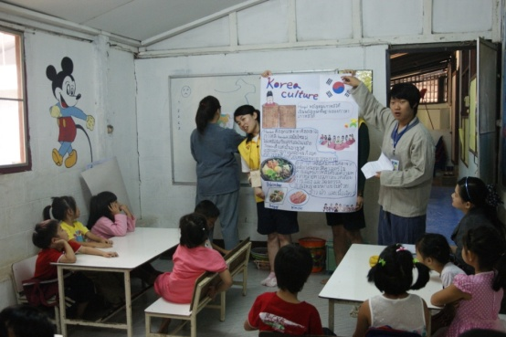
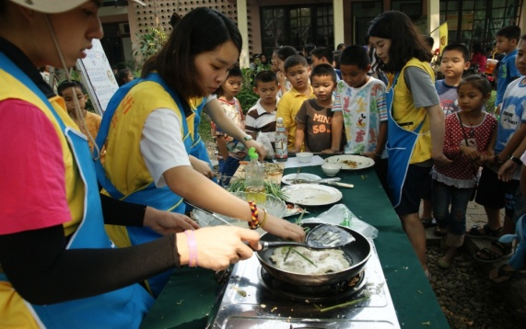
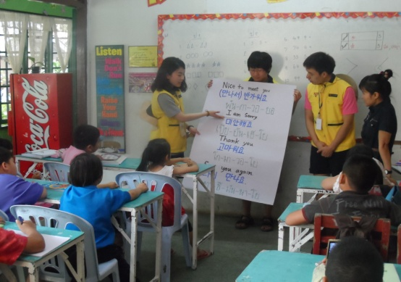
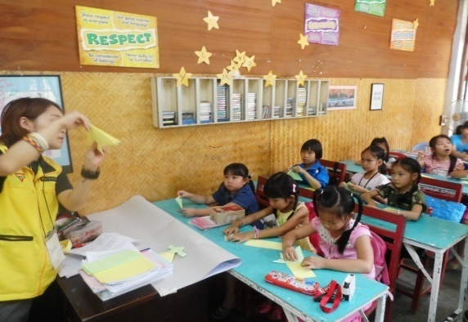
Language school
- On every Saturdays, we taught Korean cultures to students in Language school
Motivation of learning Thai language, children, concerning.
Information of communication.

Slide 21
CLP (Cleft lip / palate)

Slide 22
What is CLP ?
Cleft lip/palate
Cleft lip and cleft palate are oral malformations that occur very early in pregnancy. It results when there’s not enough tissue in the mouth or lip area, and the tissue that is available does not join together properly.

Slide 23
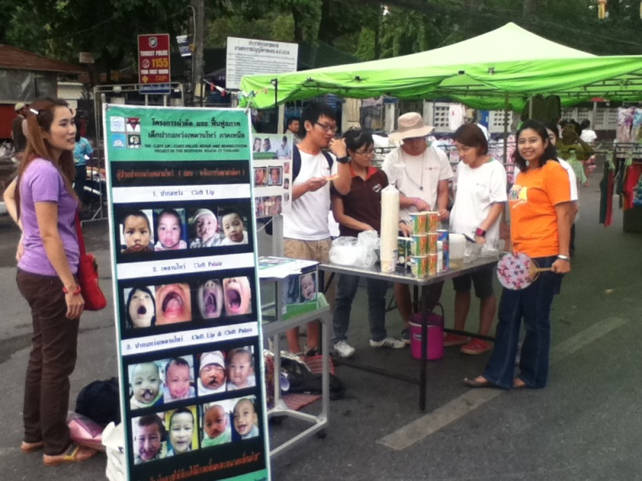
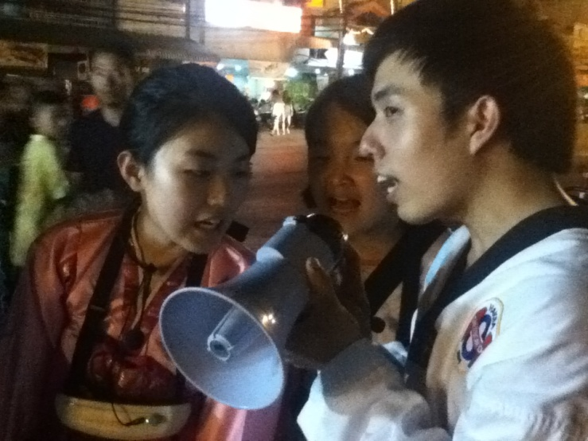
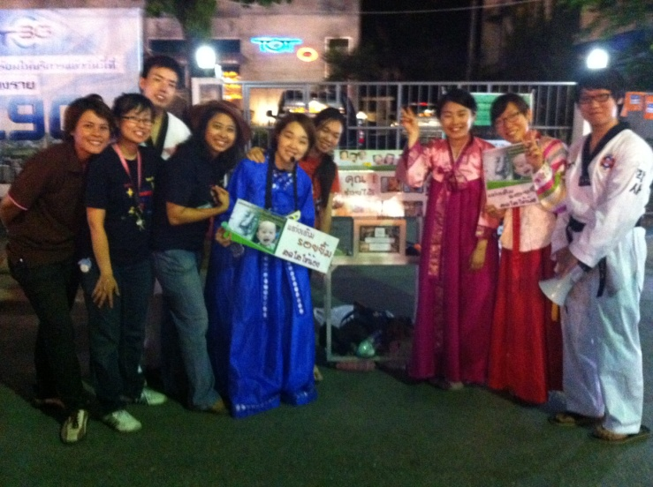
Fund raising
- We went to markets for CLP fund-raising.
Understanding & Acceptance

Slide 24
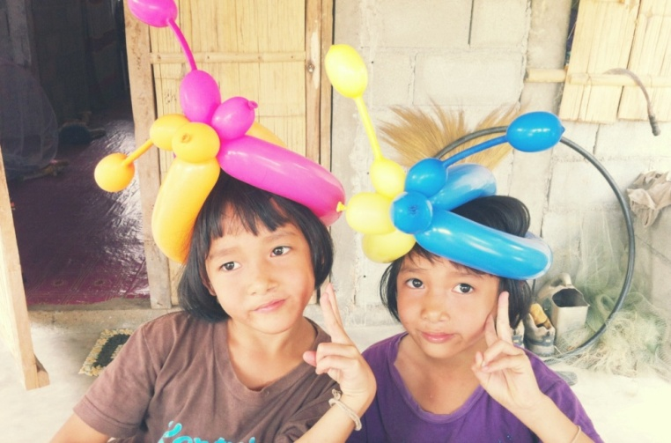
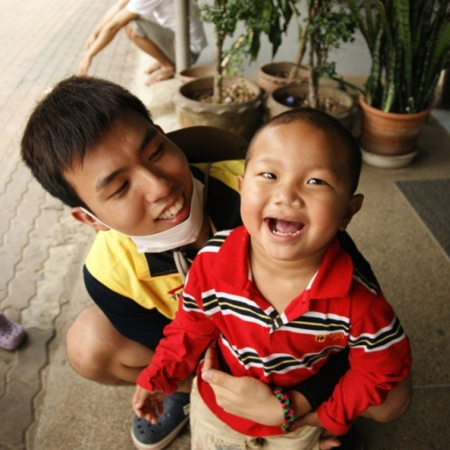
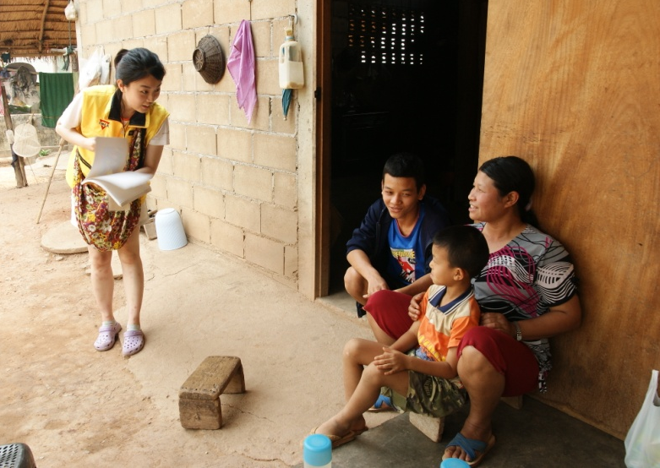
Visiting(hospital, houses)
- We visited hospital and houses of patients to see different CLP cases.

Slide 25
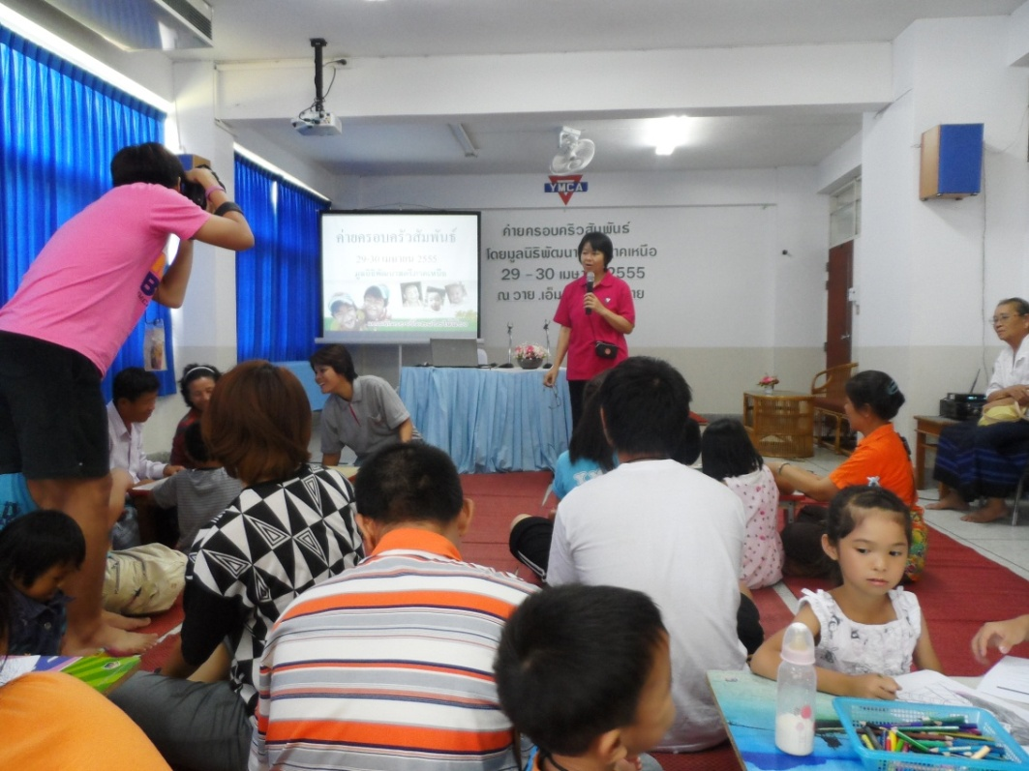
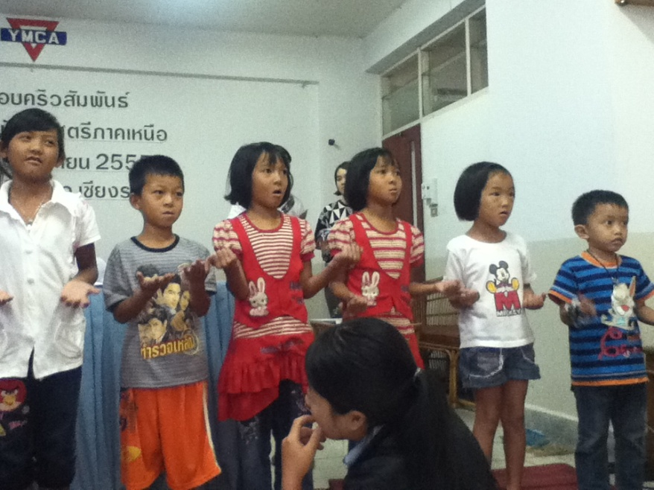
CLP family camp
- This camp was for taking care of patients after surgery, and we had a program of making toys with recyclable materials

Slide 26
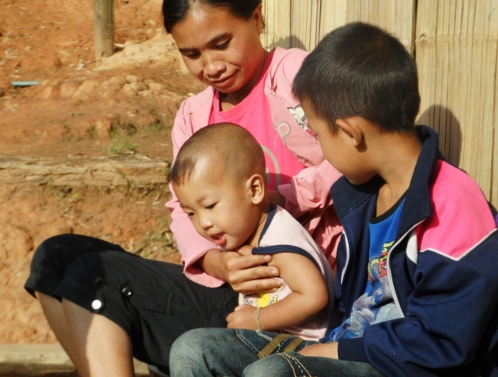
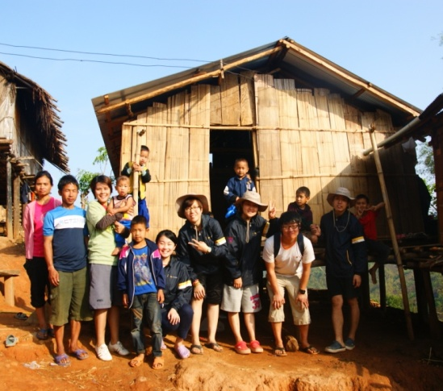
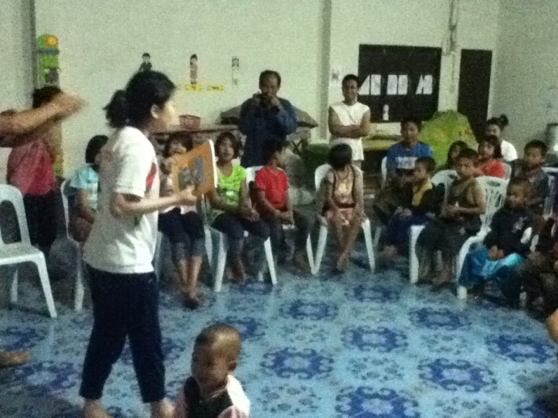
CLP Hill tribe Home-stay
- To see more CLP cases, we went to hill tribe village and stayed 1 night in there.
Environment & Nature

Slide 27
Tam dok kham village homestay (2 months)

Slide 28
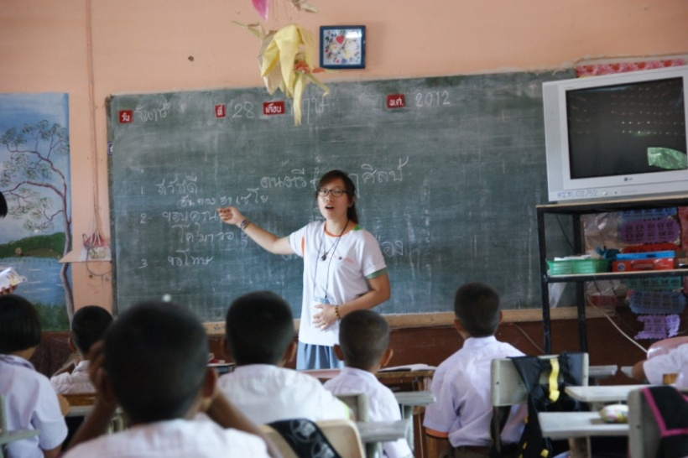
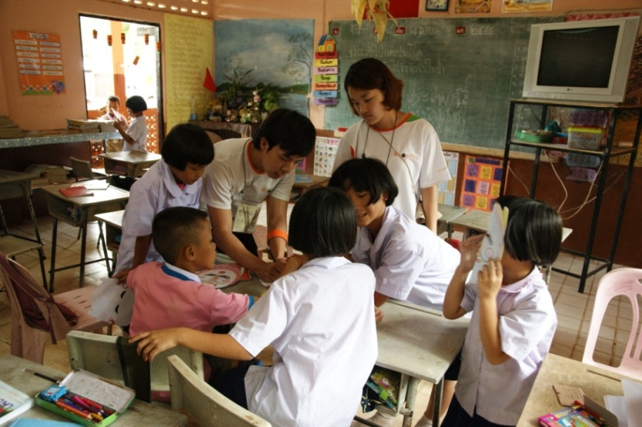
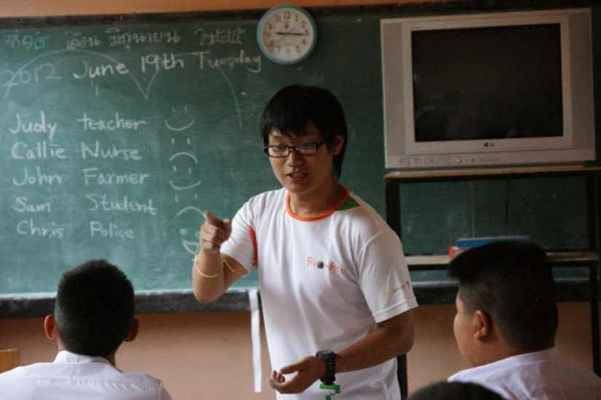
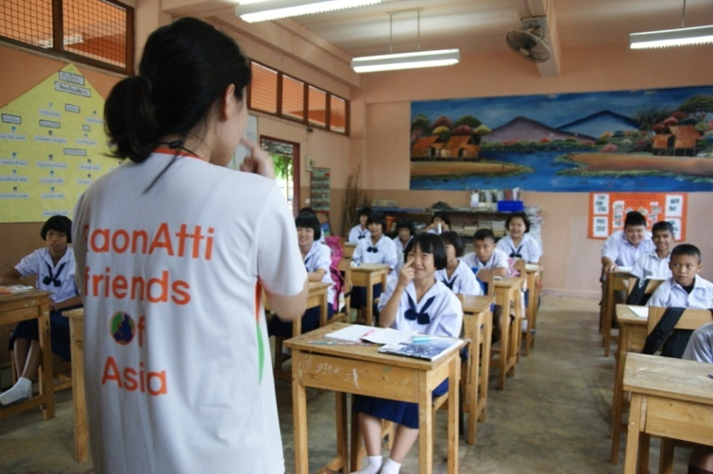
Sahakon Damri Village home-School
- In Sahakon Damri School, we’ve had our activities of teaching our majors or talents, like Art, English, and physical education. And every day for one hour, we taught Korean to students.
We were thankful that students followed us very well, even though we are not professional teacher.

Slide 29
350ppm
- On June 5th, we made posters to inform students about 350ppm
campaign. We also made a picture of big tree, with stickers of
one thing we can do for environment.
Students tried to participate with what they can do, and to get more interested in concept of 350ppm campaign.

Slide 30
Extra activities after 350ppm
- We made trash cans for recycling in school, and gave 350ppm stickers to students. We also planted many trees in the school.

Slide 31
Home staying
- Each of us stayed in different home and it put us to learn each different things.
Homestaying will remain as unforgettable memory of village life.

Slide 32
Thai culture

Slide 33
Culture
- Songkran

Slide 34
Culture
- Experience of Buddhism

Slide 35
Culture
- Village festival(Thai dance)

Slide 36
Culture
- Funeral

Slide 37
Culture
Wedding

Slide 38
Culture
- Travel

Slide 39
Our feelings through past 5 months

Slide 40
Thank you^^
Q&A

Slide 41
END

